Slide 2
Investing n that

Slide 3
UK economic cycle
Notes:
Its widely regarded that there are four phases in the UK economy (and virtually all other western economies) where do you think the uk is right now?
It currently looks like were in a fast forwarding contraction phase, into a reccssion
think of a shopping basket filled with things we typically buy. Inflation is the rate of increase in the price of that basket of items.
A little bit of inflation is helpful. But high and unstable rates of inflation can be harmful. If prices are unpredictable, it is difficult for people to plan how much they can spend, save or invest.
Britain’s economy is expected to take until 2024 to recover to pre-Covid levels amid a slowdown for hiring and business investment, as households and businesses struggle with soaring cost.

Slide 4
What are interest rates?
Notes:
An interest rate tells you how high the cost of borrowing is, or high the rewards are for saving.
So, if you’re a borrower, the interest rate is the amount you are charged for borrowing money, shown as a percentage of the total amount of the loan. The higher the percentage, the more you have to pay back, for a loan of a given size.
If you’re a saver, the savings rate tells you how much money will be paid into your account, as a percentage of your savings. The higher the savings rate, the more will be paid into your account for a given sized deposit.
Even a small change in interest rates can have a big impact. It’s important to keep an eye on whether they rise, fall or stay the same.

Slide 5
Bank of England Base Rate
The base rate is used to influence the UK economy
The current base rate is at 3%
The average two year fixed rate mortgage is now at 6.47%
Notes:
It's the rate the Bank of England charges other banks and other lenders when they borrow money, and it's currently 3.00%. The last time it was this high, was in 2008. The base rate influences the interest rates that many lenders charge for mortgages, loans and other types of credit they offer people. The average two year fixed rate mortgage is now at 6.47% (October 2022), compared to 2.43% at the start of December last year. Personally, for me, I’ve had to put off purchasing my home in the short term, as the mortgage payments have gone from around £600 to £900 a month
The Bank of England can change the base rate as a means of influencing the UK economy. Lower rates encourage people to spend more, but this can lead to inflation – an increase to living costs as goods become more expensive. Higher rates can have the opposite effect. The Bank of England reviews the base rate 8 times a year.

Slide 6
What can you get back from investing?
Depending on where you put your money it could be paid in a number of different ways:
dividends (from equity)
rent (from property)
interest (from cash deposits and fixed interest securities)
Capital gains
Notes:
Returns are the profit you earn from your investments.
Divdends are payments made by a company which represents a portion of a companies earnings
the difference between the price you pay and the price you sell for – capital gains or losses
With an instant access cash account you can withdraw money whenever you like and it’s generally considered a secure investment. The same money put into fixed interest securities, shares or property is likely to go up and down in value but should grow more over the longer term, although each is likely to grow by different amounts.

Slide 7
Why Should I invest for the long term?
Its recommended that you invest for a period of at least 5 years
Worthwhile things take time!
The amount of time you might want to invest could depend on your goals – generally speaking, the longer you invest, the better.
Notes:
Most things worthwhile take time, and effort! If you have a long time horizon, you might feel comfortable taking a bit more risk, because you have time to ride out the ups and downs of the market .
The longer you leave your funds invested, the more likely you are to be able to ride out some of the volatility in the market, along with the combined effect of benefitting from compounding interest as ali mentioned - rome wasn’t built in a day, and neither is the majority of wealth!

Slide 8
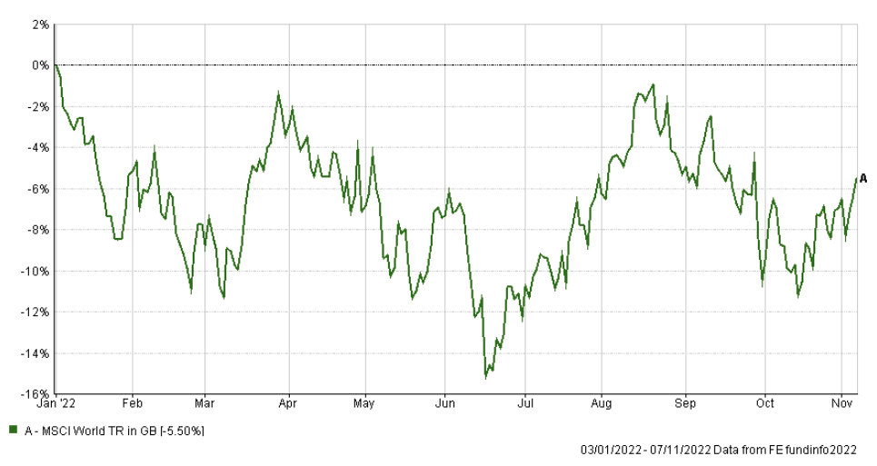
Future Value of Money
Time IN the market, not timING the market
Notes:
Chart above is a world equity index
Annualised growth of 10.94% since 1978
Behavioural finance – many people who are not used to investing or do so without advice buy high and sell low
Buy on the hype, and sell when investment start to fall in value

Slide 9
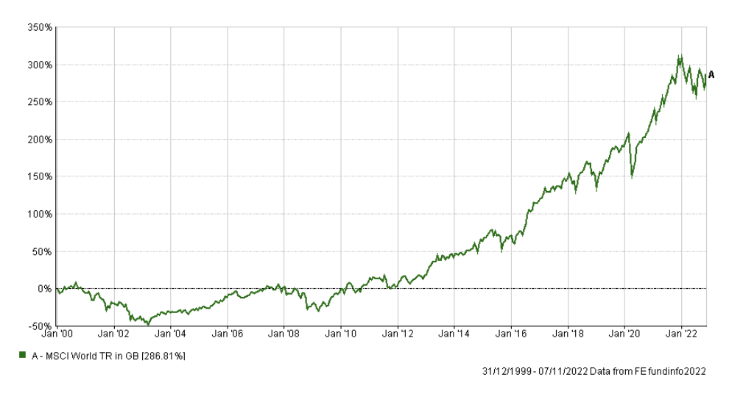
Future Value of Money
Time IN the market, not timING the market
Notes:
Chart above is a world equity index
Annualised growth of 10.94% since 1978
Behavioural finance – many people who are not used to investing or do so without advice buy high and sell low
Buy on the hype, and sell when investment start to fall in value
If invested at the turn of the millennium, wouldn’t have seen a positive return on investment for around 11 years

Slide 10
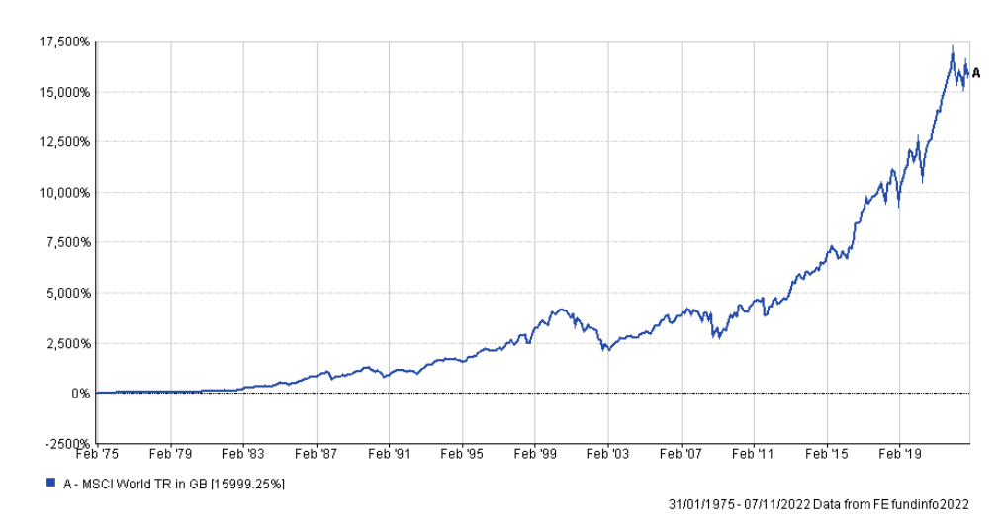
Future Value of Money
Time IN the market, not timING the market
Notes:
Chart above is a world equity index
Annualised growth of 10.94% since 1978
Behavioural finance – many people who are not used to investing or do so without advice buy high and sell low
Buy on the hype, and sell when investment start to fall in value

Slide 11
The big risk…
The more risk you take, the more you can get back, or lose!
Notes:
None of us likes to gamble with our savings, but the truth is that there’s no such thing as a ‘no-risk’ investment.
At the heart of investing there is a simple trade-off: the more risk you take, the more you can get back or lose (and the lower the risk you take, the less you’re likely to get back or lose).
But while you’re always taking on some risk when you invest, the amount varies between different types of investment.
Inflation risk - With cash, money you place in secure deposits such as savings accounts risks losing value in real terms (buying power) over time.
This is because the interest rate paid on cash accounts won’t always keep up with rising prices (inflation). Interest rates are currently quite good for savings accounts, but its still much lower than the rate of inflation.
Interest risk - On the other hand, index-linked investments that follow the rate of inflation don’t always follow market interest rates. This means that if inflation falls you could earn less in interest than you expected.
Capital risk – as a general rule, if you aim for higher returns you must be willing to take a higher risk. This is because where higher returns can potentially be earned there is also a greater chance of a drop in the value of your investment. You need to find a balance between the risk to your capital that you can cope with and the returns you need to reach your investment goals.
Market risk - this is the risk of a fall in the stock market of the country where your money is invested. When an index such as the FTSE 100 falls, most shares usually fall too.
Performance risk – there is no guarantee that your investment is going to perform well!

Slide 12
What is a fund?
Funds are a ready-made basket of investments.
There are two main types of funds-
Active or multi fund
Passive or index fund
Which can come in two varieties –
Inc – Income fund
Acc – Accumulation fund
Notes:
Funds are a ready-made basket of investments. When you invest in funds, you’re buying into a mix of assets (like the previous page!)
The great thing about funds is you’re not putting all your eggs into one basket. Instead, your money goes into a range of investments. This is known as diversification and it can be an effective method for spreading your risk. That’s because if some of the investments in the fund perform badly over a certain period, others may perform well.
There are 2 main types of fund:
an active or multi-asset fund - is run by a professional fund manager who chooses which shares, bonds or other assets to hold and monitors them on your behalf. You pay extra for the fund manager's expertise with the aim of receiving returns which outperform the market
a passive fund or index fund – this simply follows or tracks a given market or index. As there is no active involvement from the fund manager, passive funds generally charge less in fees
So with that, we’ve got two potential types of a fund
Inc –which would be an income fund – with this, any interest or dividend income from the fund will be paid to you. If the fund is invested into bonds, you’ll usually receive a fixed rate of interest, where as if you’re invested into equities, you may get an income in the form of dividends.
Acc – accumulation so with this, any income generated from the fund is reinvested into the fund – so this increases the value of your investment instead of paying that income out to you.
Diversification – pooled investmnts (investment funds) contain hundreds to thousands of individual assets, meaning if one fails / defaults, then it won’t have much of an impact on the rest of the fund. If you hold shares in just a few companies, if one fails (like MADE.com is in the process of) then that will have a much wider impact on your portfolio once the administrators have been in and stripped the carceass.

Slide 13
Asset Types
Notes:
Monies can be invested into a range of assets directly or collectively. Although, some are more difficult to invest into directly than others. The main asset classes are as follows:
Cash – you could hold this in your bank or building society account, or you could invest into a money market fund.
Fixed interest – this constitutes loans to governments or companies.
Equities – these are shares in a company.
Property – this could be residential or commercial property.
Commodities – these could be ‘hard’ or ‘soft’, but would usually be accessed collectively. It is quite difficult, and somewhat illegal, to purchase and store barrels of crude oil!
Each of these assets have varying levels of risk, and can indeed carry unique risks (such as inflation risk).
As you can see, the more risk taken, the higher the chance of reward.

Slide 14
What does a fund look like?
Notes:
So this pie chart is the asset allocation of the Aviva Pension My Future Focus Growth which is a generic fund Aviva tend to use for workplace pensions (as Holly showed you yesterday). An asset allocation is when you divide your investment portfolio between different assets – if an asset allocation is well diversified, it can maximise the growth potential for the level of risk you are taking. As you can see, the fund is made up of a mixture of assrts, spread across both the international market, and uk market. The fund is invested into c.77% ‘higher risk’ assets such as Property and Equities, with the rest of the allocation invested into ‘lower risk assets’.
Looking at this, would you say that is a high risk investment? If so, why might this be suitable for a pension?
So yeh, this fund is aimed at someone whos more than 15 years away from retirement, so is investing for a long term. Again, the theory here being that because your further away from retirement, you’ve got more time to tolerate any ups and downs in the market.
Another point again on this fund, is that because its within your pension wrapper – any growth is tax free.

Slide 15
Performance
Notes:
So this graph shows Vanguard LifeStrategy range – the funds within this go from 20% equities (a much lower amount of that risker investment) up to 100% (which is fully invested into equities). You can see from the graph, that over the past 10 years, the risker funds have seen the highest amount of growth – with the 100% fund showing 177%, which is quite nice isn’t it! On the flipside however, if we look at the performance between January 2020 and December 2020, you can see that the 100% equity fund also had the biggest drop – and actually had the worst performance in that period time.

Slide 16
Investing – why?
Maintain or improve buying power of funds (beat inflation, basically)
Inflation measures the rising costs of goods over time
Long term target is 2% per year, but currently sitting at around 11%
Notes:
Big Macs are not only delicious, but also a relatable economic indicator.
In 2006 Michael, a very cautious person, puts £100 aside in a deposit account and thinks “Fantastic, that will be enough to buy 50 Big Mac burgers (£2 each) to celebrate my retirement in 2020.”
Roll on 2020, Michael’s £100 has grown to £107, based on the average interest growth on his account of 0.75% per annum over 14 years.
This can only buy him 33 Big Mac burgers as the price has increased, more or less in line with inflation, to £3.19 per burger.
Michael is very sad about this as his retirement goal has not been met ☹
Contrast this to Andrew, who wisely invested his £100 at the same time and for the same purpose.
His investment achieved an average growth of 5% per annum over the 14 years, meaning he now has £198.
In 2020, Andrew is now able to purchase 62 Big Mac burgers!
Andrew is very happy about this because he met his retirement goal ☺

Slide 17
Future Value of Money
Compounding is key
A little saved now could mean a LOT in the future
£25 a month over 1 years = £303 (cash)
£25 a month over 5 years = £1,986
£25 a month over 10 years = £5,391
£25 a month over 20 years = £20,554
£25 a month over 30 years = £61,321
£25 a month over 40 years = £168,814
Notes:
Link to Tuesday’s session – little round-up accounts
£25 a month, something you likely wouldn’t feel if you set up a direct debit
Less than half the cost of a new phone on contract
About the same as 6 pints of beer

Slide 18
Future Value of Money
Some scenarios:
 | Investing – ISA vs grossed Pension |  | Cash in normal savings account
 | £200 per month | £250 per month | £200 per month
5 years | £15,889 | £19,861 | £13,108.00
10 years | £43,132 | £53,916 | £28,945.00
20 years | £164,449 | £205,568 | £70,565.00
30 years | £490,626 | £613,307 | £129,026.00
40 years | £1,350,678 | £1,688,424 | £209,705.00
Notes:
Growth is exponential so 10x invested is 10x returns
As Holly mentioned, the earlier you start investing the better
£250 is a canny amount per month but these days is much less than what people might spend on a new car on finance

Slide 19
How do I invest?
Share trading platforms not ideal
Don’t follow finance influencers on social media
Can access investments through many direct providers like
Nutmeg
Moneybox (can invest your round-ups directly)
Vanguard
Hargreaves Lansdown
AJ Bell Youinvest
Notes:
Long-term – home improvements / extensions / kitchens etc
Short-term – 0% finance agreements ending, Christmas savings plans, holidays etc
All about striking a good balance between lifestyle

Slide 20
Wrappers
Dictate rules that apply to investments
 | Pension | ISA | LISA
Bonuses | 20% on personal contributions | N/A | 25% bonus
Limitations | £40k a year limit | £20k a year limit | £4k a year conts Under-40 to open one
Access | 25% tax free Rest taxable as income | Penalty-free | 25% penalty if not buying first home / age 60
When to use | Retirement, so very long term (except for Jo) | Medium term investing for spare money | Buying first home; when pension allowance maxed

Slide 21
Sustainable Investing

Slide 22
ESG
Environmental factors
Social Factors
Governance factors
Examples?
Whole idea is to eliminate risks to companies arising from these.
For instance, with current energy prices, companies who are self-sufficient energy-wise will be faring a lot better
Notes:
Not for ethical reasons or doing anything ‘green’ or good
More like ‘how are these gonna hurt my profits’ because money talks

Slide 23
Environmental
Social
Governance
Stance on climate change
Resource depletion
Waste
Pollution
Deforestation
Human rights
Modern slavery
Child labour
Working conditions
Employee relations
Bribery and corruption
Executive pay
Board diversity / structure
Lobbying and donations
Tax strategy
Currently up to fund managers to score ESG factors themselves
… which is akin to letting a student grade their own exam paper
Regulation on the way!
Notes:
Not for ethical reasons or doing anything ‘green’ or good
More like ‘how are these gonna hurt my profits’ because money talks

Slide 24
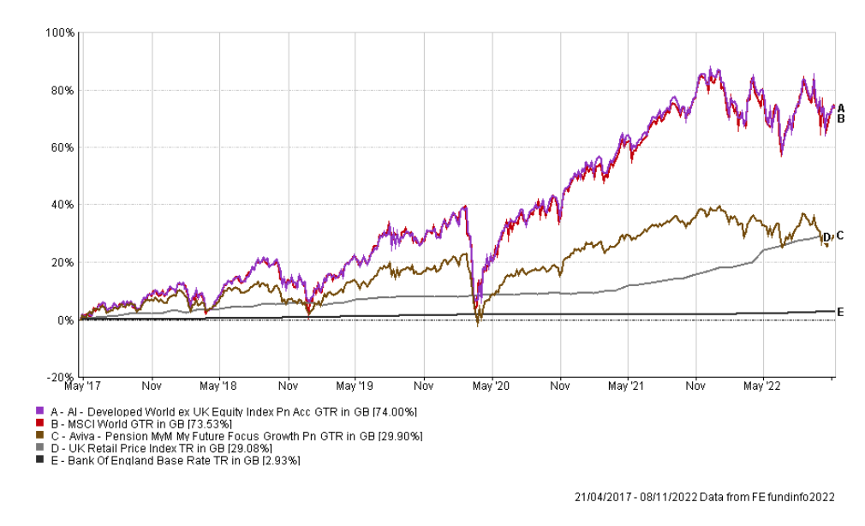
“What should I put my pension in then?”
Not advice but this is where mine is:
Sam Lennie: “I wanna invest in the top line”
The top line - BlackRock World ex-UK Equity Index Tracker
“Instead of trying to find the needle in the haystack, just buy the haystack”
Charge – 0.00%
Notes:
Not for ethical reasons or doing anything ‘green’ or good
More like ‘how are these gonna hurt my profits’ because money talks

Slide 25
Shares

Slide 26
Tax Efficiency of Shares
Shares can be beneficial in 2 ways:
Capital growth (i.e. growth in the monetary value linked to the company)
Dividend payments – company profits paid out to shareholders
Everyone has a capital gains tax allowance of £12,300 per year
This will only comes into play when you sell shares makes profit
Everyone has a £2,000 per year tax-free dividend allowance

Slide 27
EMI Share Scheme
Each own a little bit of Verve
Company is divided up into 900,000 shares
We have the option to purchase 125 shares per year of service up to 500 shares
EMI scheme allows shares to be issued on backdated value so will be based on the company being valued at £54,400 (6.6p per share), and 500 shares will cost you £33 should you exercise your option
If Verve were to be valued at £900,000 today then your shares would be worth £500
If Verve were to be valued at £30,000,000 in 10 years’ time then your shares would be worth £16,667 (50,406% return)

Slide 30
Title
Test
Test
Test

Slide 31
Title
Test
Test
Test

Slide 32
Section Title

Slide 33
Title
Test
Test
Test

Slide 34
Section Title

Slide 35
Title
Test
Test
Test

Slide 36
Section Title

Slide 37
Title
Test
Test
Test

Slide 38
Title
Test
Test
Test

