Slide 2
Welcome!
Talk Money Week – Money Workshop
Sli.do #moneymoney

Slide 3
Pensions
Your Aviva Pension

Slide 4
Why would you invest in a pension?
Tax relief at your highest marginal rate.
Underlying investments free from Capital Gains Tax and Income Tax.
Amazing death benefits
Flexible ways to access.

Slide 5
Contributions.
Your contributions are paid to the pension AFTER tax.
You pay the net amount to the scheme (no tax added).
Pension provider claims basic tax relief from HMRC.
This grosses your contribution up.
£87.50
GROSS
£70 NET
BASIC RATE
PENSION POT
HMRC
£17.50
TAX RELIEF
TAX RELIEF

Slide 6
Contributions.
Gross to net?
X 0.80
Net to gross?
/ 0.80

Slide 7
Your Aviva Pension.

Slide 8
The default investment strategy.

Slide 9
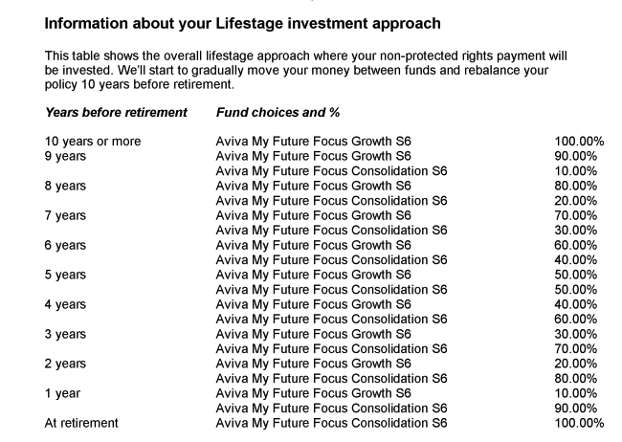
The default investment strategy.

Slide 10
Aviva My Future Focus Growth Fund

Slide 11
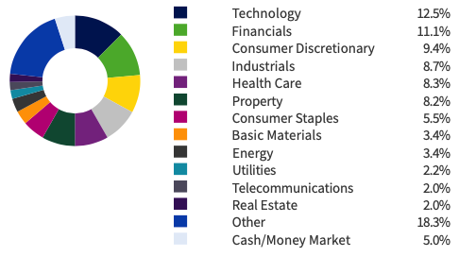
Asset Allocation expanded
Top 10 holdings in the fund
Sector Breakdown
Total: 9%

Slide 12
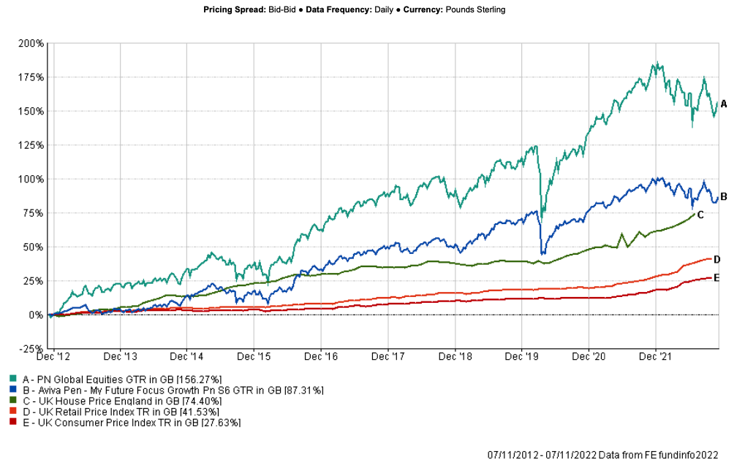
What does investing achieve?

Slide 13
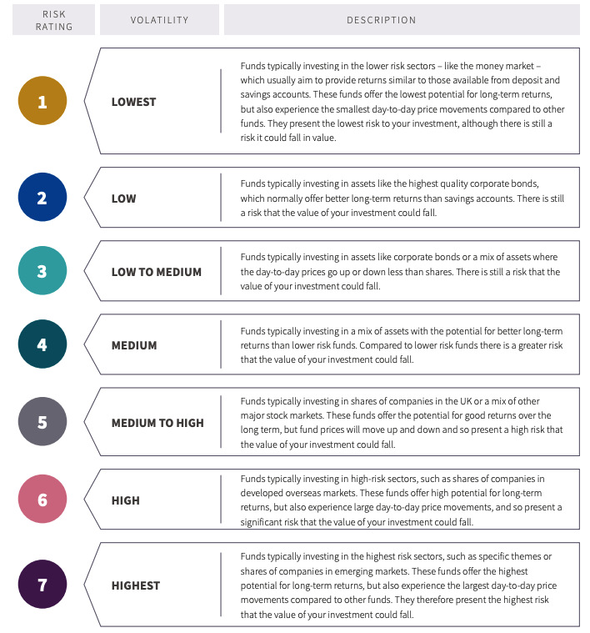
Alternative funds
Aviva risk scale
Aviva have 250+ funds available across a range of risk levels and investment styles

Slide 14
Investment styles
Active
Passive/Index
Managed by an individual or team of managers
The fund manager(s) decide what to invest in and in what proportion, based on their own judgements
Automatically tracks a certain group of shares or an entire index
No tactical decisions are made, with the investment process based on holding whatever makes up the index.

Slide 15
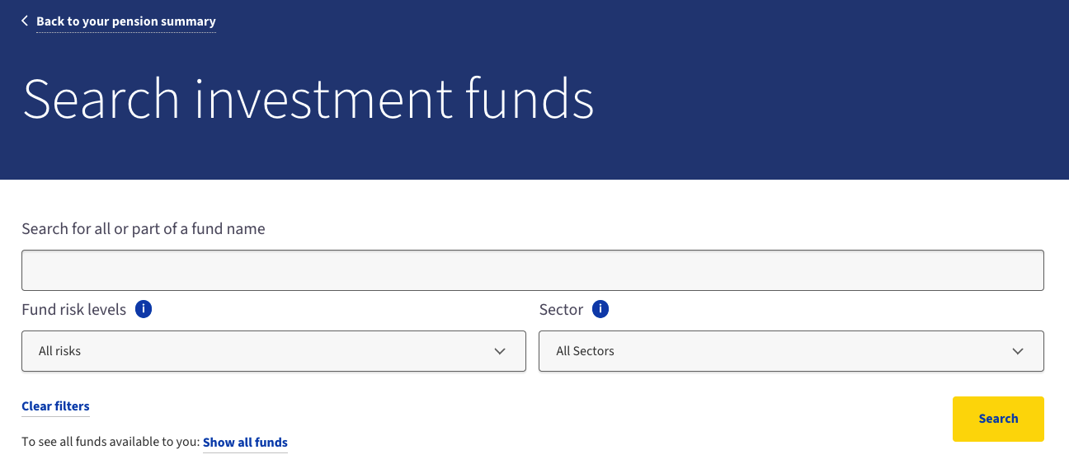
Searching for funds

Slide 16
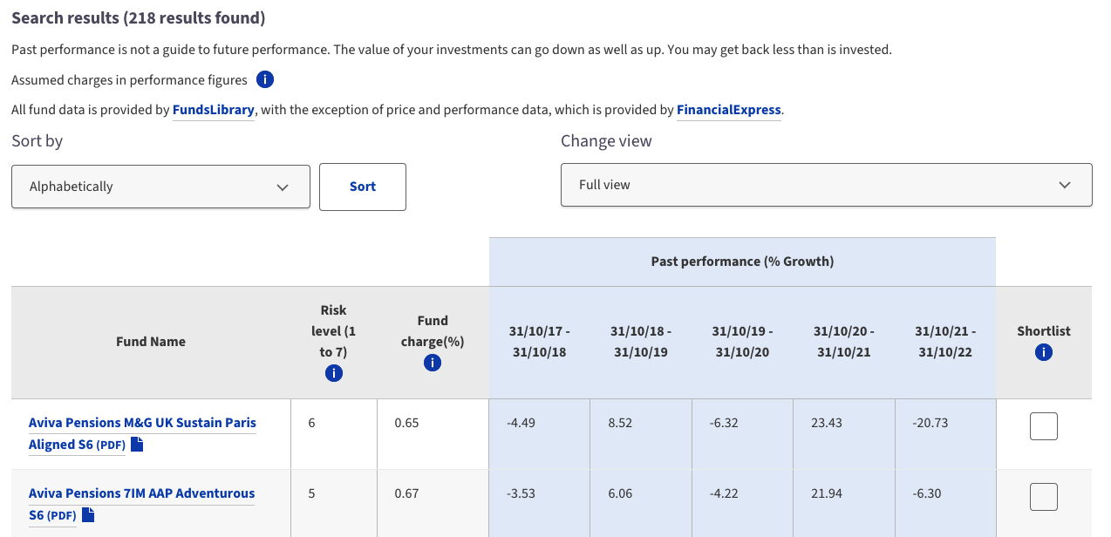
Searching for funds

Slide 17
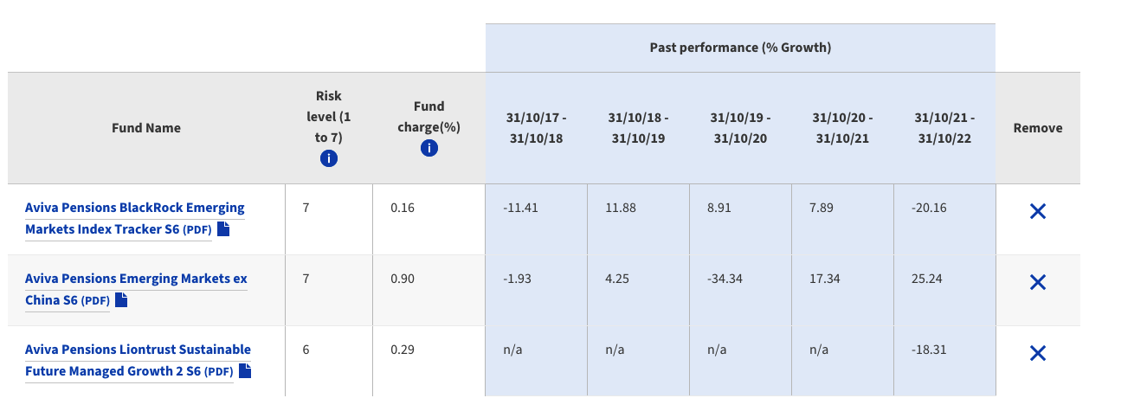
Searching for funds

Slide 18
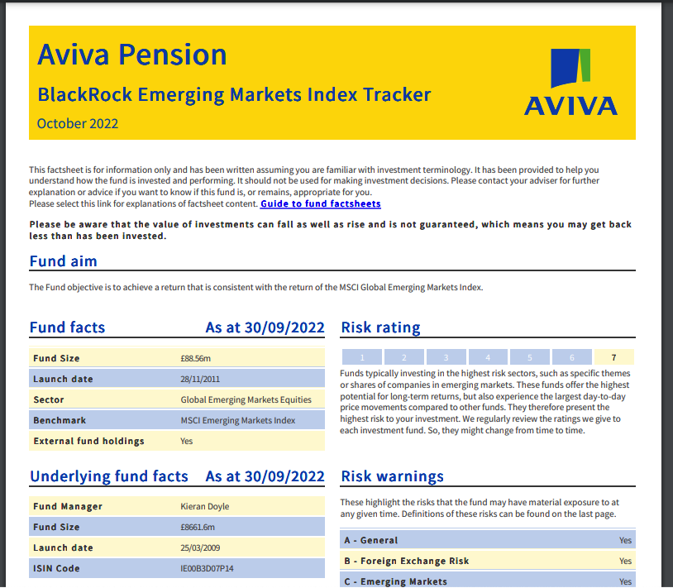
Searching for funds

Slide 19
Charges
What are their effects?

Slide 20
Charges
Each fund will have charges of:
The 'extra management charge' which is applied when using third-party funds
The fund manager expense charge (FMEC)
Transactional costs
Highest charges
Lowest charges
Anything from 0.04% to 2.06% is possible

Slide 21
Charges – The effect over time
Contributions of £100 per month.
25 years.
5% growth.
Any ideas on what this may look like?

Slide 22
Consolidating
Switching your pensions.

Slide 23
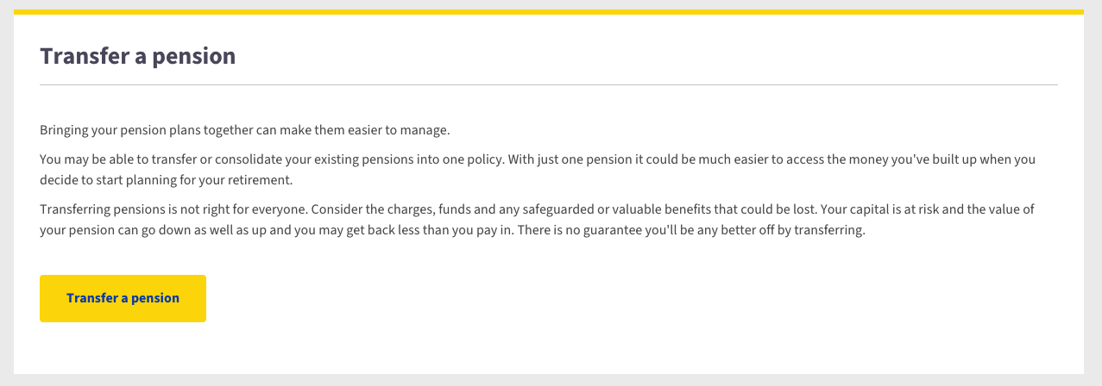
Switching your pension.

Slide 24
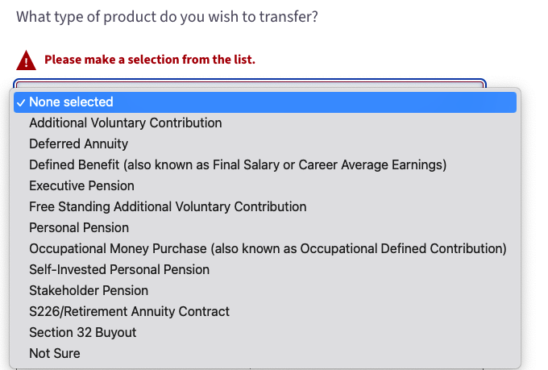
Switching your pension.
The type of pension you’re switching.
The name of the provider.
The policy number.
The approx. fund value.
And whether or not the pension has safeguarded benefits.

Slide 25
Tracking down lost pensions
With auto enrolment, people will join and leave pension schemes potentially numerous times over their working life
It is easy to forget about pensions that you were enrolled into, particularly if you were at the job for a short period of time.
https://www.gov.uk/find-pension-contact-details to search for contact details or to request help from the pension tracing services
https://www.moneyhelper.org.uk/en/pensions-and-retirement/pension-problems/tracing-and-finding-lost-pensions is a good resource for how to obtain information on a pension once you have the contact details.

Slide 26
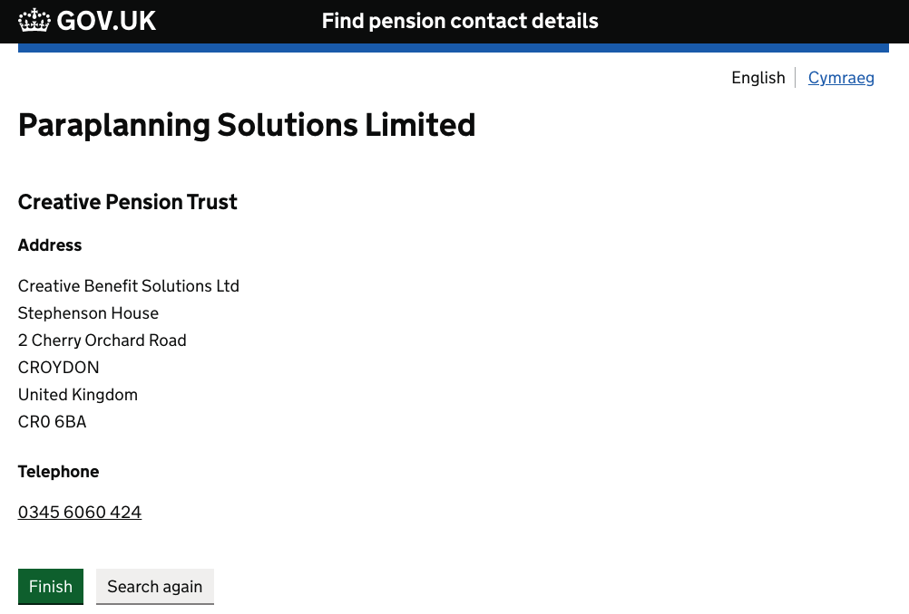
Tracking down lost pensions
Using the GOV.UK service to search for the old Para-Sols workplace pension

